Slide 1
William Stallings
Computer Organization and Architecture
7th Edition
Chapter 13
Reduced Instruction Set Computers
v/s
Complex Instruction Set Computers

Slide 2
Introduction
Hardware fused with software (Intel v/s Apple)
Intel’s hardware oriented approach is termed as CISC while that of Apple is RISC
Instruction Set Architecture- Interface to allow easy communication between the programmer and the hardware.
ISA- execution of data, copying data, deleting it, editing
Instruction Set , Addressing Modes,

Slide 3
RISC-Reduced Instruction Set Computer
RISC processor design has separate digital circuitry in the control unit
Signals needed for the execution of each instruction in the instruction set of the processor.
Examples of RISC processors:
  IBM RS6000, MC88100
  DEC’s Alpha 21064, 21164 and 21264 processors

Slide 4
CISC-Complex Instruction Set Computer
Control unit →micro-electronic circuitry
- generates a set of control signals →activated by a micro-code
The primary goal of CISC architecture is to complete a task in as few lines of assembly code as possible.
Examples of CISC processors are:
  Intel 386, 486, Pentium, Pentium Pro, Pentium II, Pentium III
  Motorola’s 68000, 68020, 68040, etc.

Slide 5
CISC processor features
Instruction set with 120-350 instructions
Variable instruction/data formats
Small set of general purpose registers(8-24)
A large number of addressing modes
High dependency on micro program
Complex instructions to support HLL features

Slide 6
CISC processor features
Complex pipelining
Many functional chips needed to design a computer using CISC
Difficult to design a superscalar processor

Slide 7
RISC processor features
Instruction set with limited number of instructions
Simple instruction format
Large set of CPU registers
Very few addressing modes
Easy to construct a superscalar processor

Slide 8
RISC processor features
Hardwired control unit for sequencing microinstructions
Supports on chip cache memory
All functional units on a single chip
Simple pipelining

Slide 9
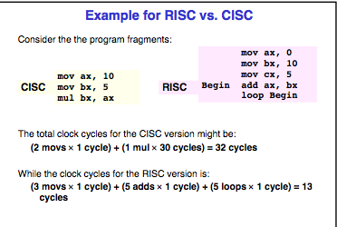

Slide 10
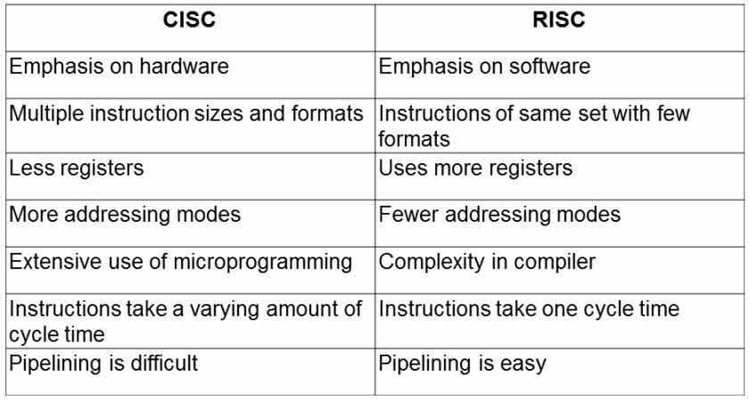


Slide 11
RISC Pipelining
Most instructions are register to register
Two phases of execution, I E
  I: Instruction fetch
  E: Execute
    ALU operation with register input and output
For load and store(memory),I E D
  I: Instruction fetch
  E: Execute
    Calculate memory address
  D: Memory
    Register to memory or memory to register operation

Slide 12
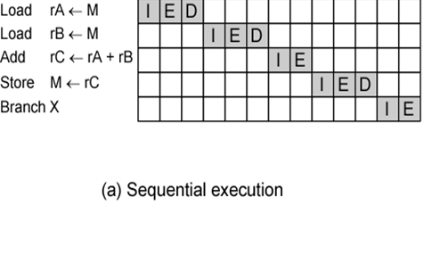

Slide 13
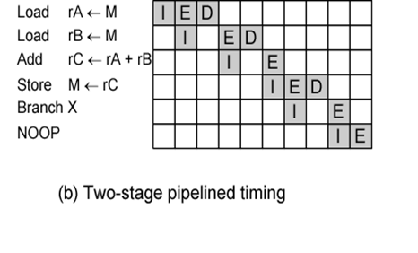

Slide 14
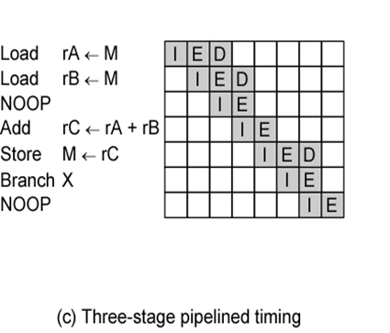

Slide 15
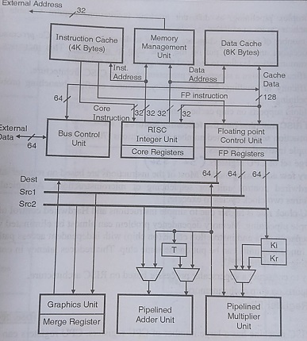
RISC Architecture

Slide 16
RISC Architecture
9 functional units interconnected by multiple data paths with width ranging from 32-128 bits
All internal- external buses are 32 bit wide
Separate instruction (4KB)and data cache(8KB)
MMU- implements paged virtual memory structure
RISC integer unit executes load,store,fetch etc
2 floating point units , multiplier unit and adder unit
Graphics unit to support 3D drawing

Slide 17
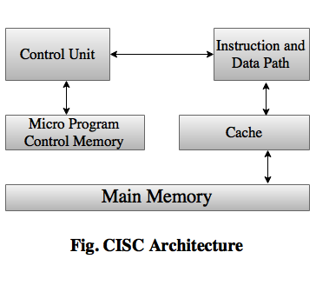
CISC Architecture

Slide 18
